Slide 1
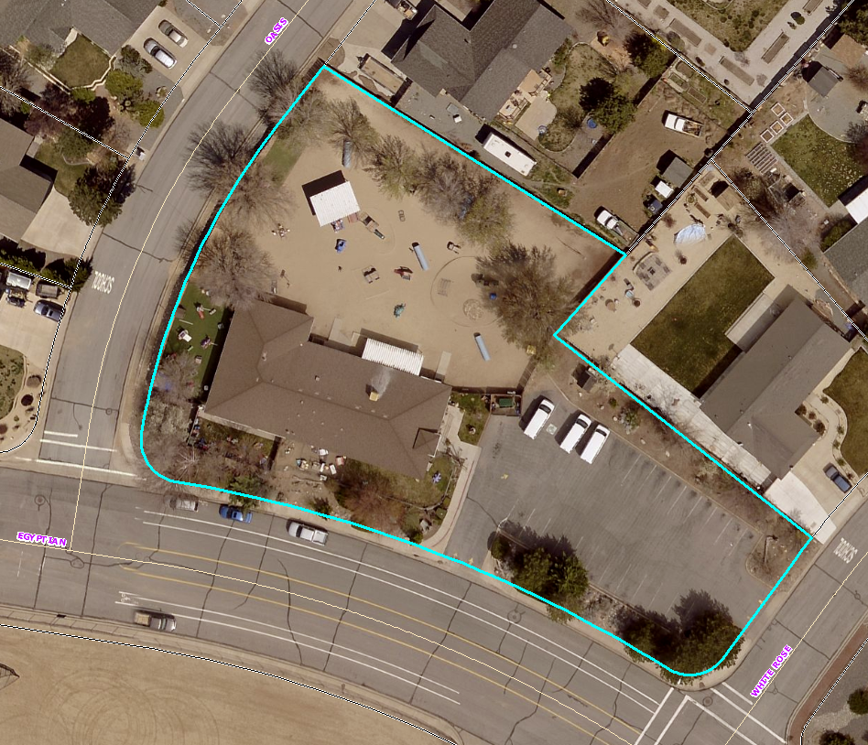
Washoe County Board of Adjustment
WSUP18-0013 (Discoveries Preschool)
August 2, 2018

Slide 2
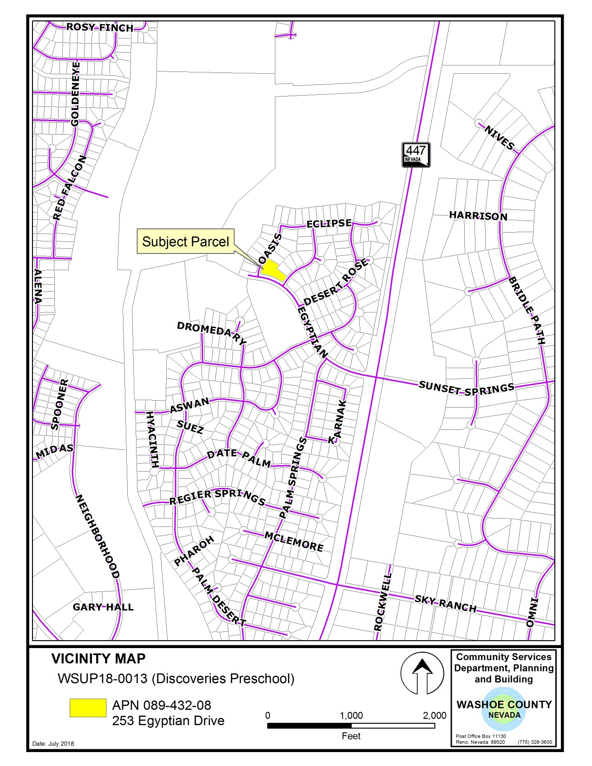

Slide 3
Background/Overview
Request to expand an existing child daycare facility by constructing a 1,408 sf addition
New child daycare regulations for the amount of square footage required per student
Expansion would include additional classroom space and 2 new bathroom facilities
Addition would enable compliance with new child daycare regulations – stay in business as currently operating

Slide 4
Background/Overview
Facility is currently licensed for a maximum of 106 students and 15 staff
No new student capacity is requested (or enabled)
The facility was originally approved by special use permit (SUP) in 1992 – has been in continuous operation since opening
The 1992 SUP authorized up to 80 children, 20 infants, and 12 to 15 employees

Slide 5
Background/Overview
Current license parameters and operations are similar to this number (only slightly higher by 6 students); however,
The addition exceeds a 10% expansion of an existing use (i.e. ~30% expansion) and thus triggers the need for a new special use permit
Existing operations do not appear to create any undue impacts – no complaints have been received

Slide 6
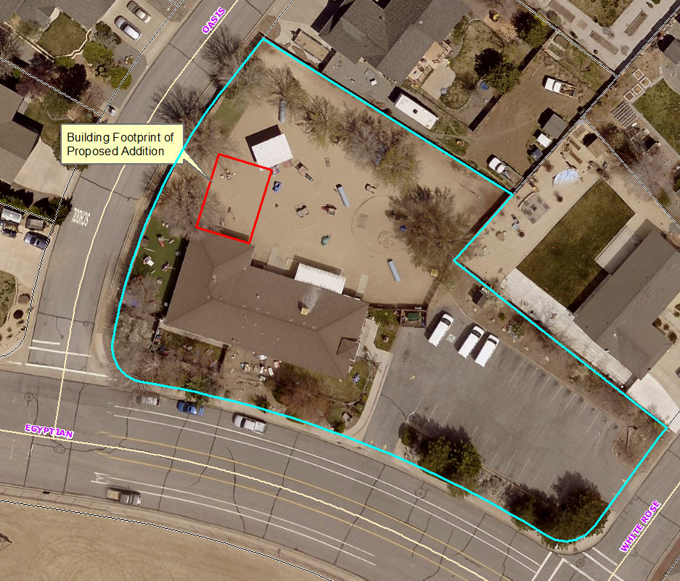
Aerial View w/Request

Slide 7
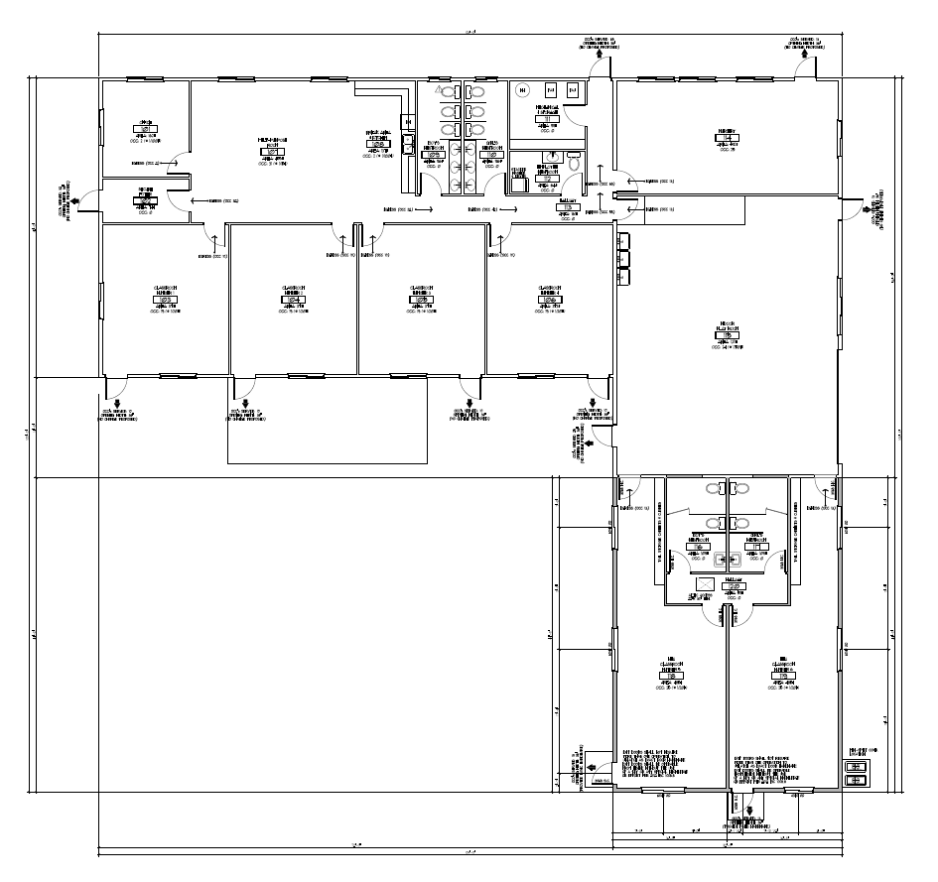
Floor Plan

Slide 8
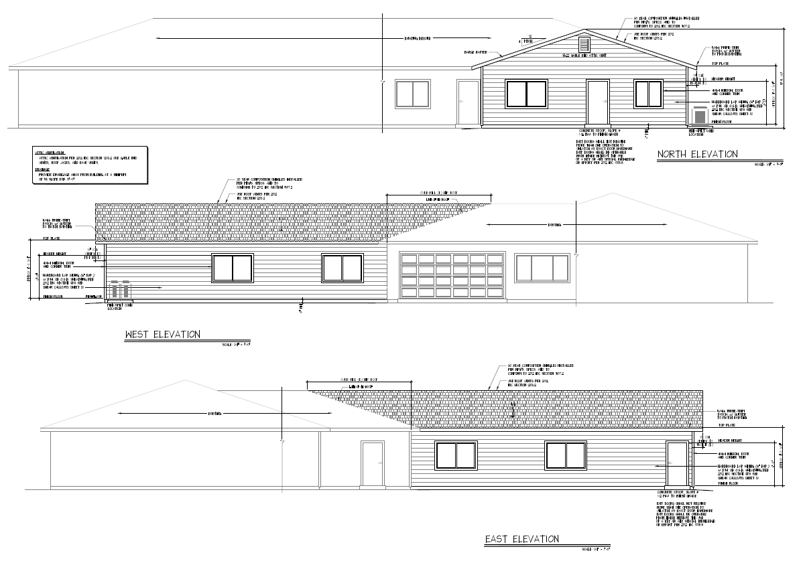
Building Elevations

Slide 9
Analysis
The 1 acre property is currently zoned MDS – child daycare is an allowed use in MDS (w/SUP)
Proposed addition will meet required setbacks
Existing landscaping and parking meets code requirements
Expansion will not trigger the need for additional landscaping or parking
No parking or landscaping will be removed – proposed in a DG play area

Slide 10
Analysis
New lighting will be minimal and down shielded
Architecturally compatible (color, design, and building materials)
No change is proposed to existing hours operation of 6:30 a.m. to 6 p.m.
No increased traffic generation
NDEP will approve expansion using existing 5,000 gallon septic tank/leach system
Not on a well – TMWA water, has fire sprinklers

Slide 11
Public Notice and CAB
Notice was sent to 42 affected property owners that were within 500 feet
No comments received from noticed owners
Spanish Springs CAB reviewed the application on July 11, 2018
The CAB voted 3-0 to recommend approval
No substantive comments from the CAB review

Slide 12
Reviewing Agencies
Washoe County Community Services Department
Planning and Building Division
Engineering and Capital Projects; Traffic, Land Development, and Utilities
Regional Transportation District
Truckee Meadows Fire Protection District
District Health, Environmental Health Services
Nevada Department of Environmental Protection

Slide 13
Special Use Permit Findings
Consistency with the Master Plan
Adequate Improvements
Site Suitability
No Detriment
No effect on a military installation

Slide 14
Possible Motion
I move that, after giving reasoned consideration to the information contained in the staff report and information received during the public hearing, the Washoe County Board of Adjustment approve, with conditions, Special Use Permit Case Number WSUP18-0013 for Discoveries Preschool, having made all five findings in accordance with Washoe County Code Section 110.810.30

